Slide 1
Whitebeam’s Art and DT Exhibition work

Slide 2
At the start of the year the children sketched their portraits from a photograph of themselves after experimenting with different sketching techniques.
After looking at autumn colours in the school grounds, the children painted backgrounds using sponging techniques. They cut out silhouettes of trees.

Slide 3
During the course of this year Whitebeam studied the work of different artists including Andy Warhol. They looked at the style of his work and composed their own pop art using images of their hands.
We also enjoyed designing and painting our own willow pattern plates.

Slide 4
Using the Tate Gallery web link to explore the work of Henry Moore, the children created their own abstract sculptures of people from clay.
During our topic of Under the Sea the class designed and made their own sea creatures using mod roc and paint.

Slide 5
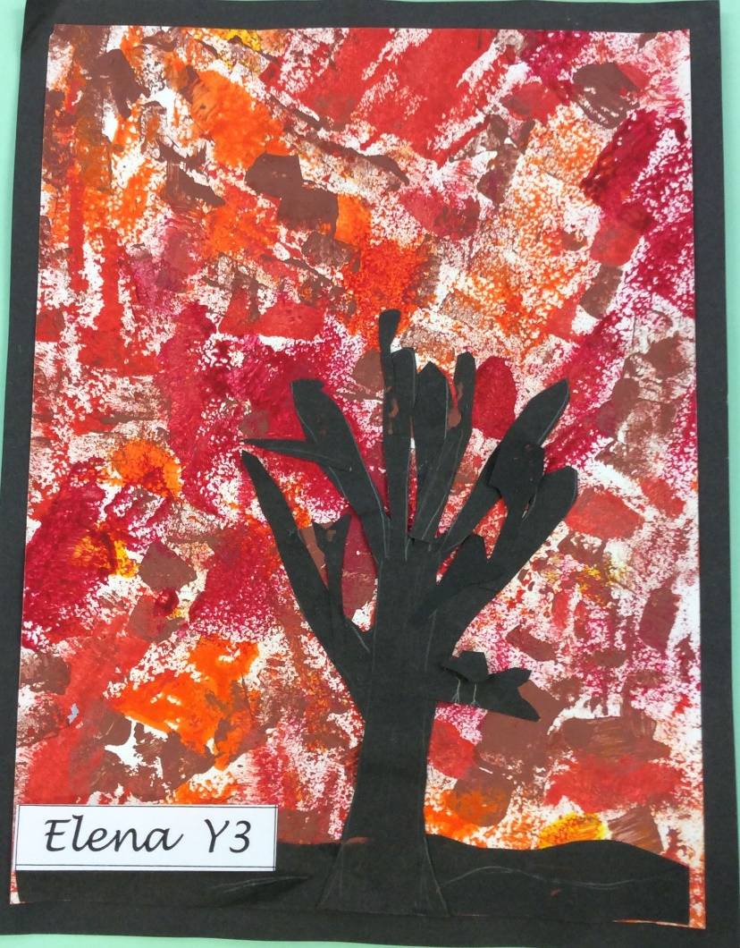

Slide 6
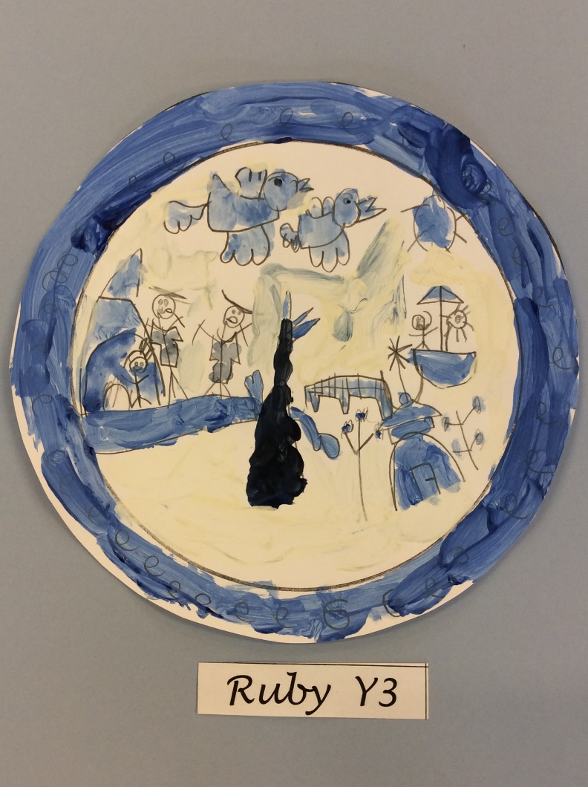

Slide 7
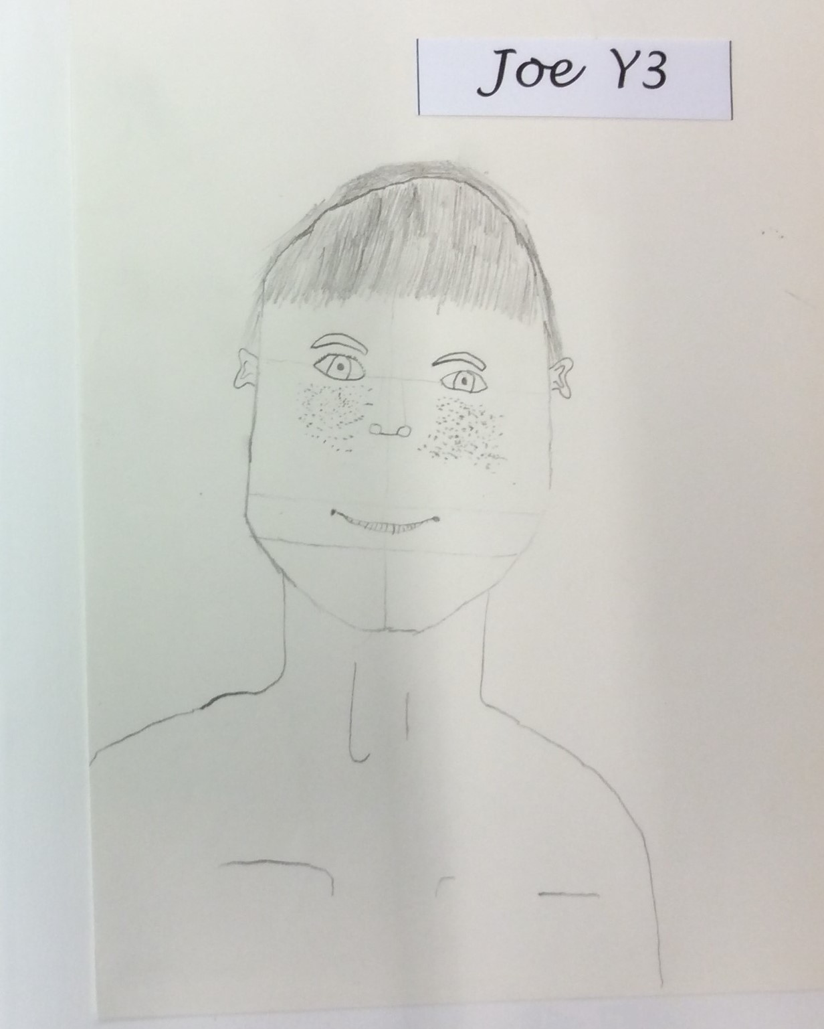

Slide 8
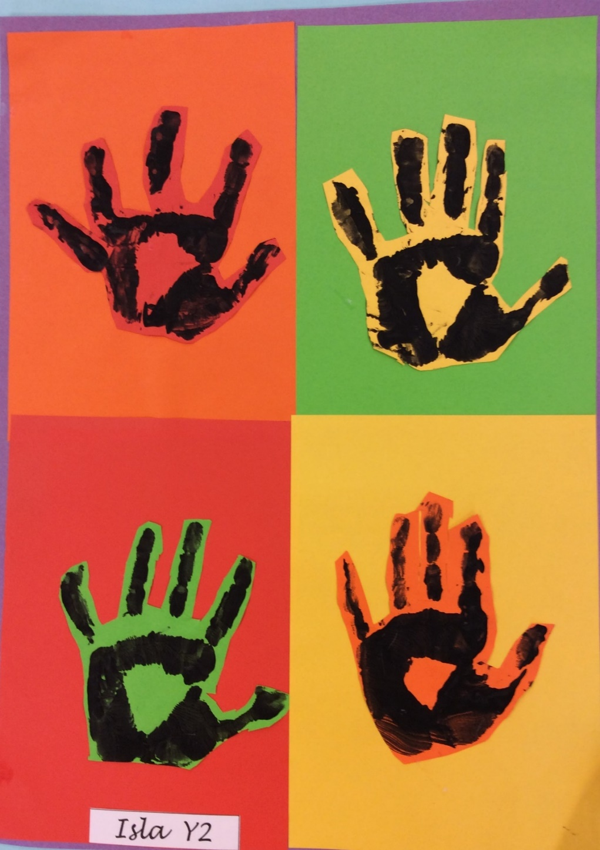

Slide 9
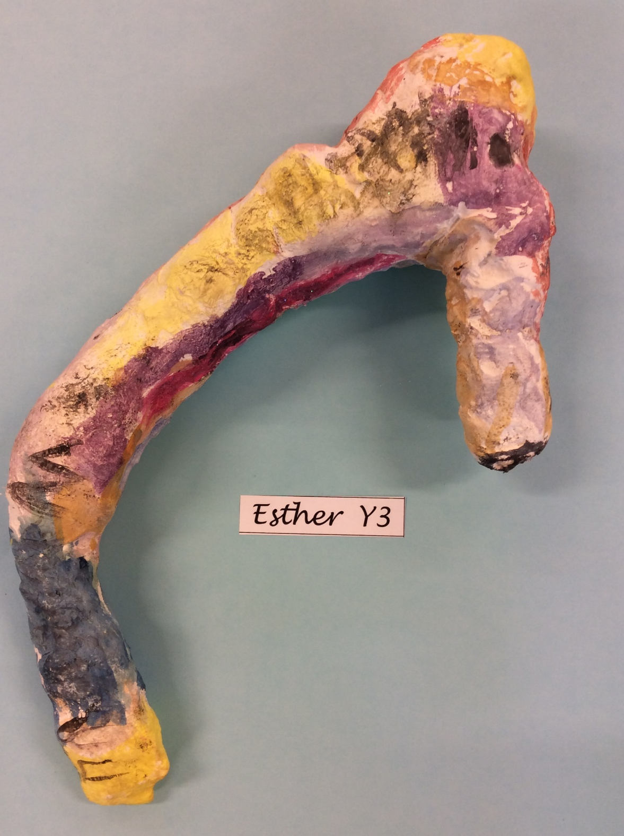

Slide 10
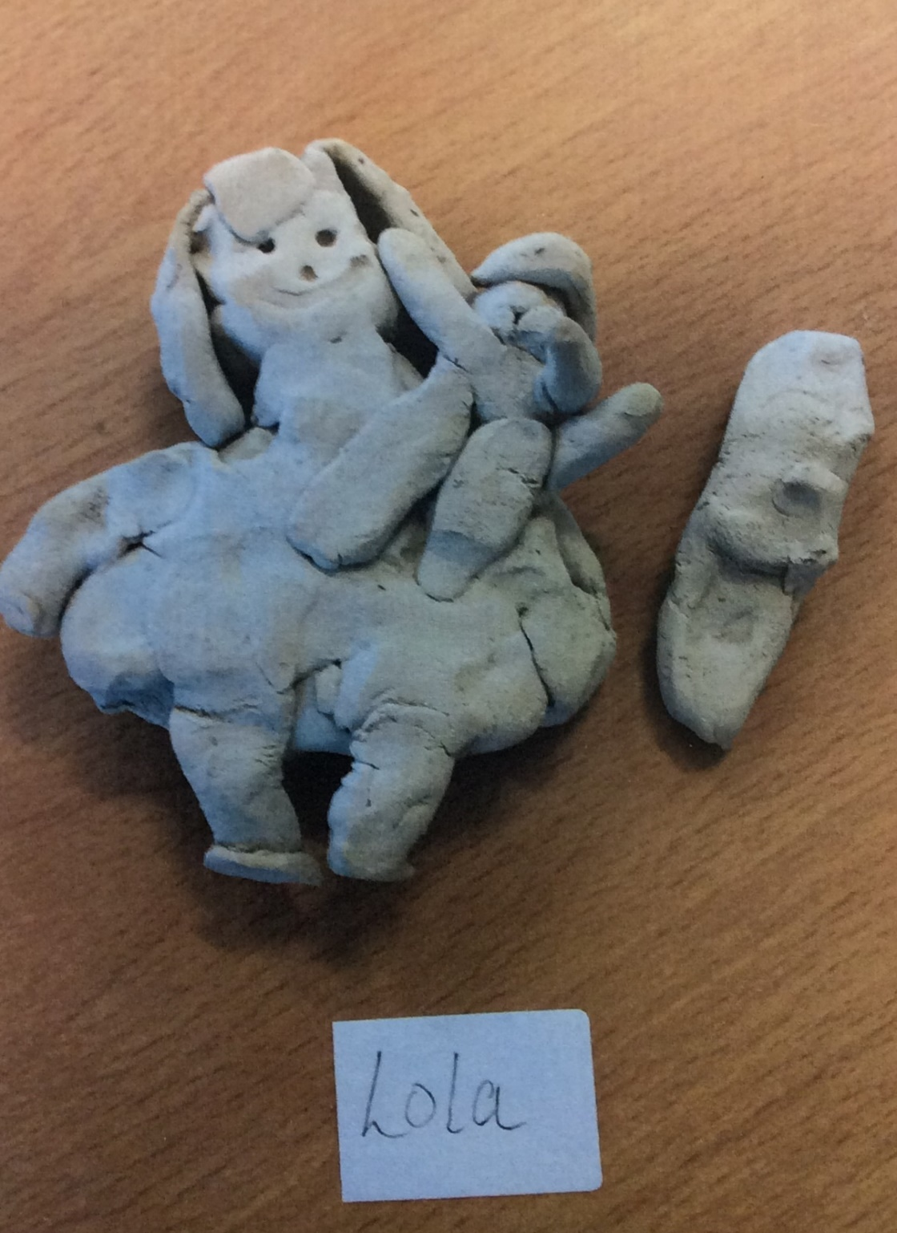
Lola
Yr 2

Slide 11
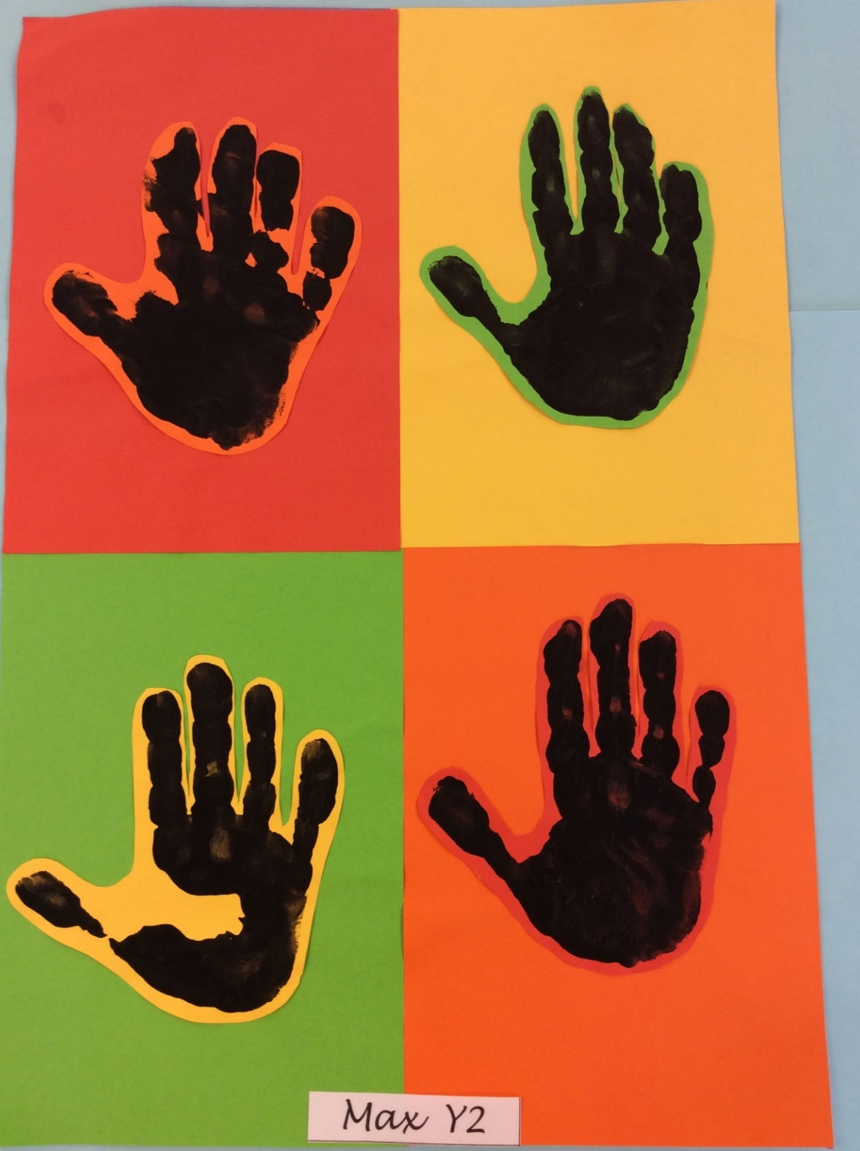

Slide 12
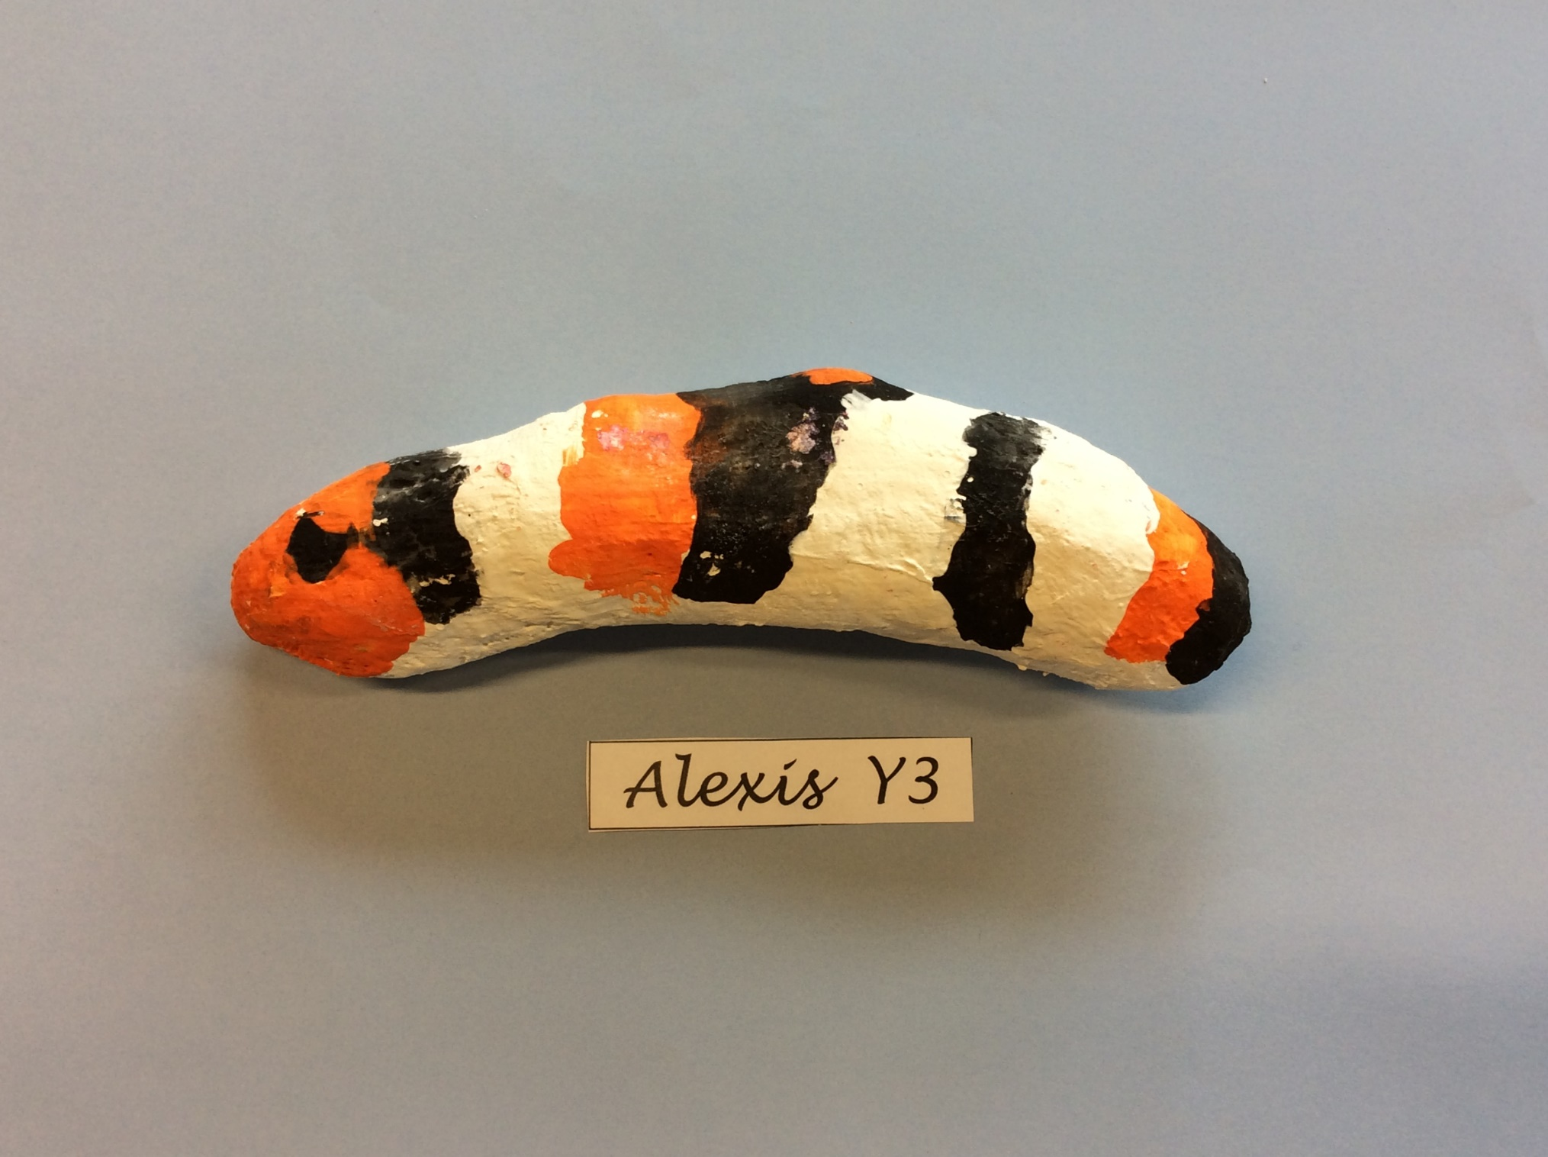

Slide 13
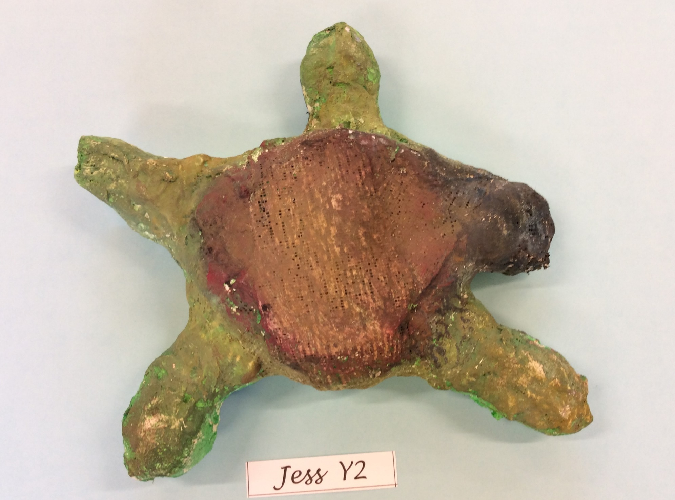

Slide 14
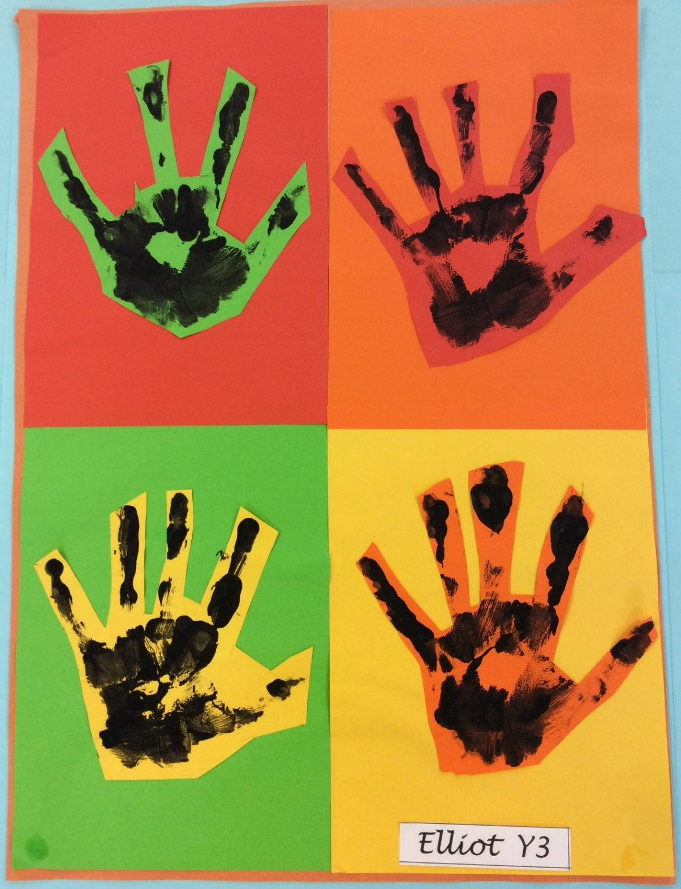

Slide 15
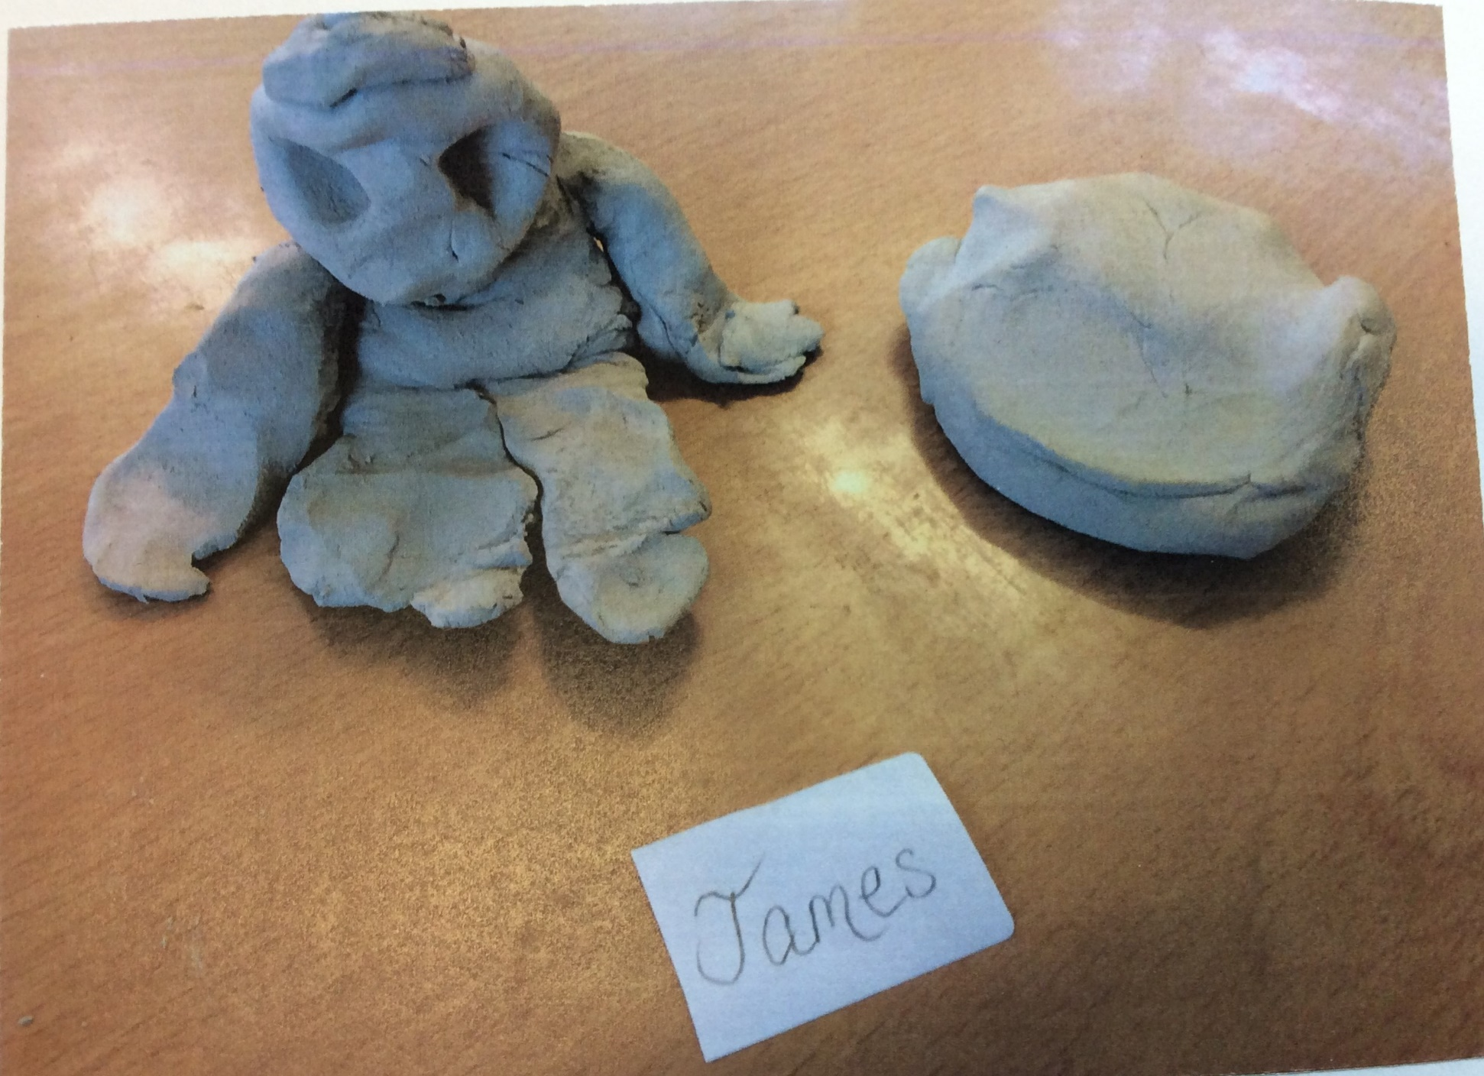
James
Yr 2

Slide 16
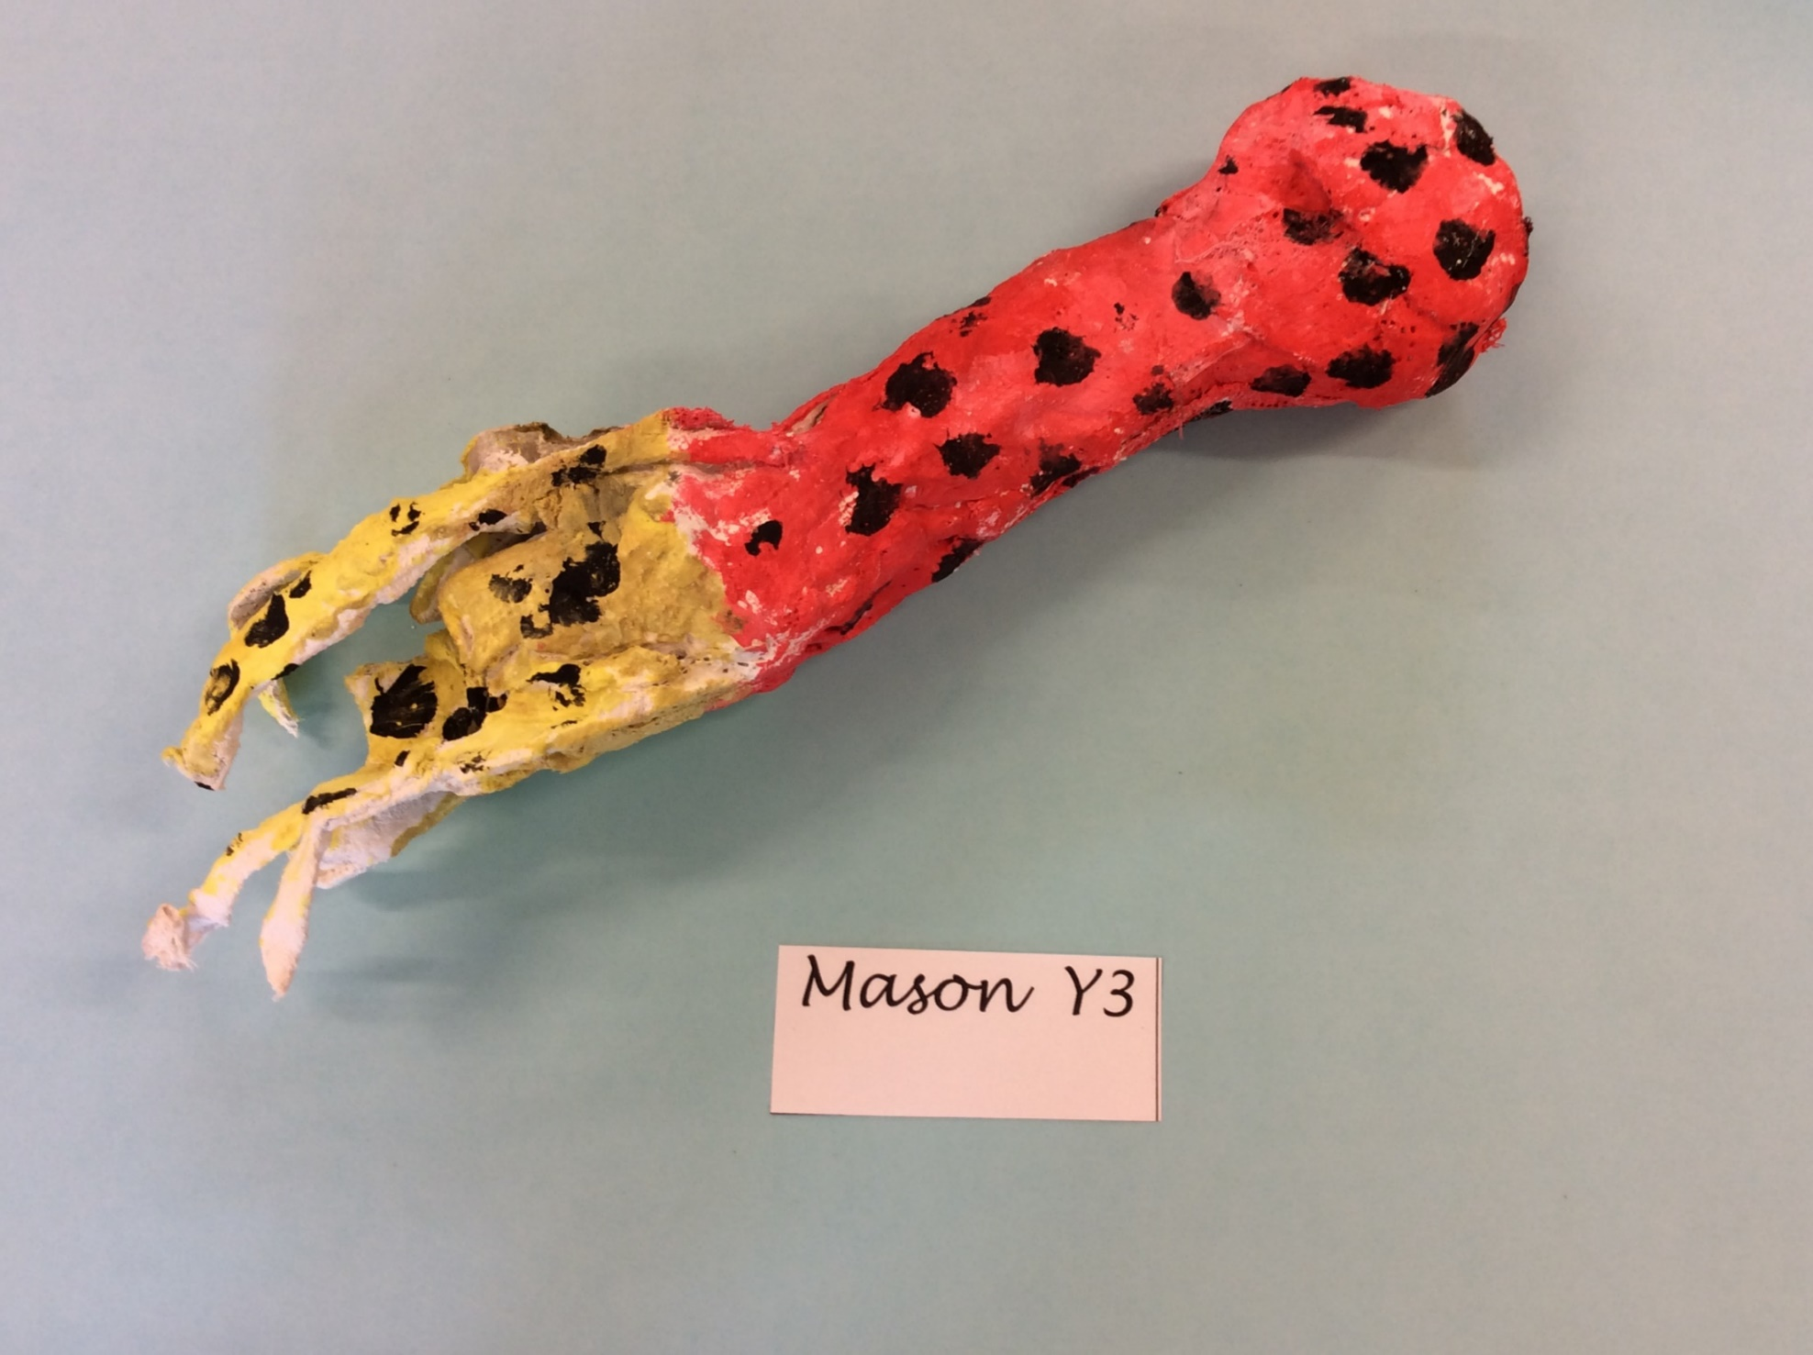

Slide 17
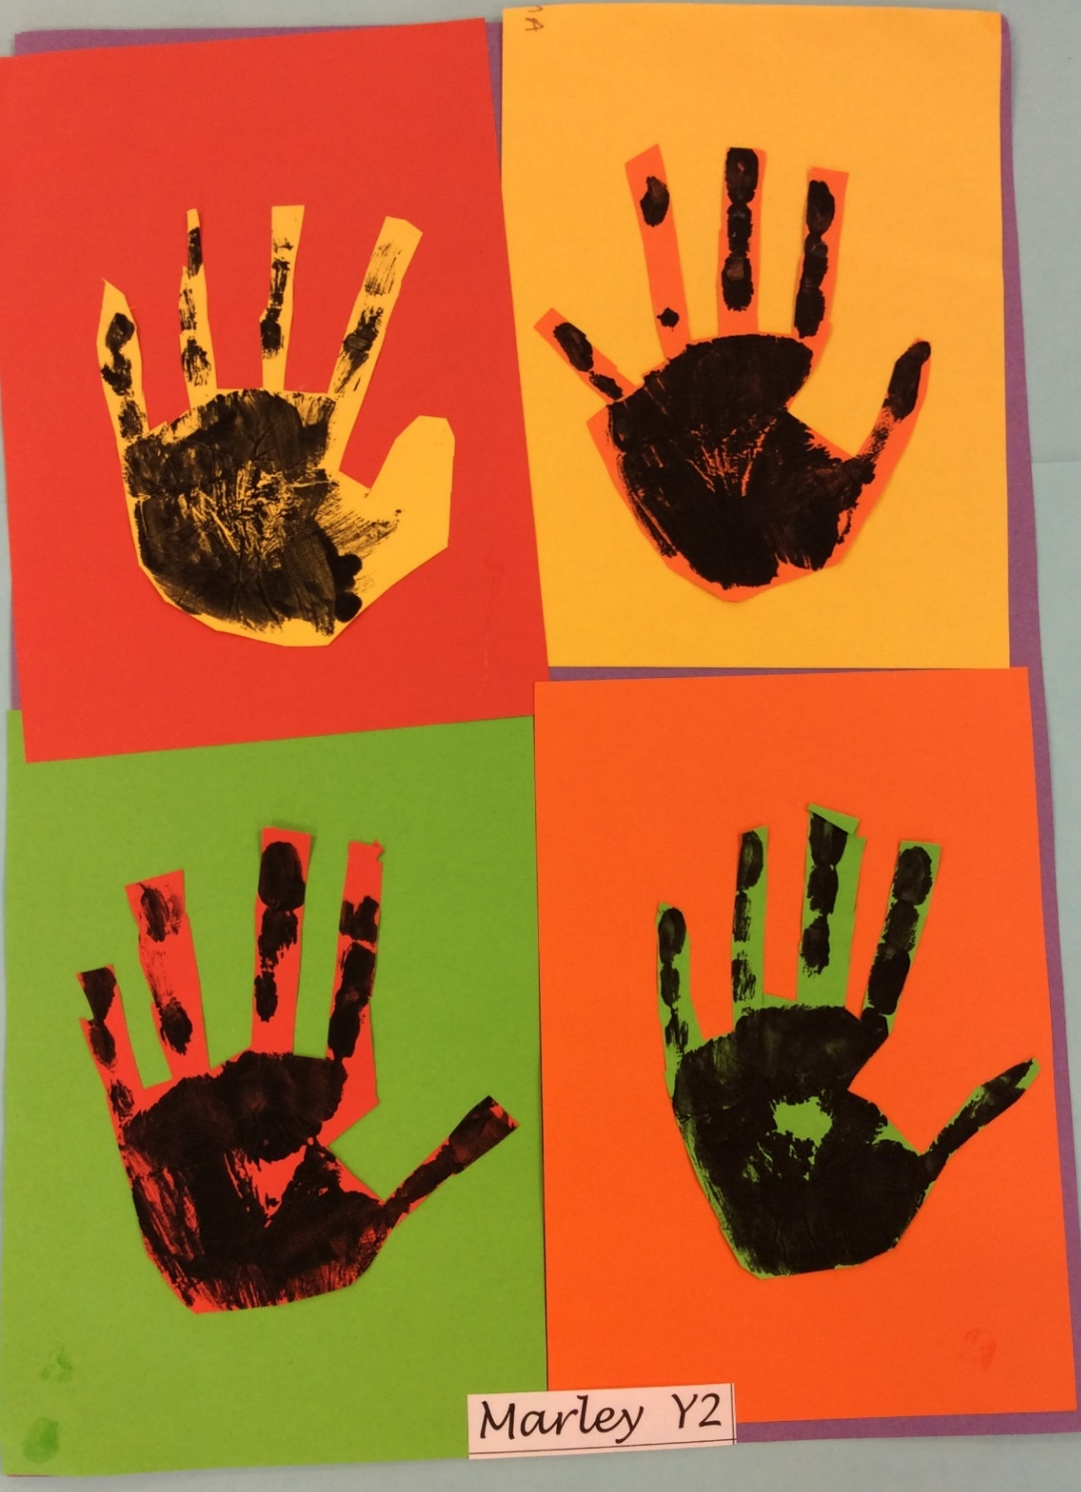

Slide 18
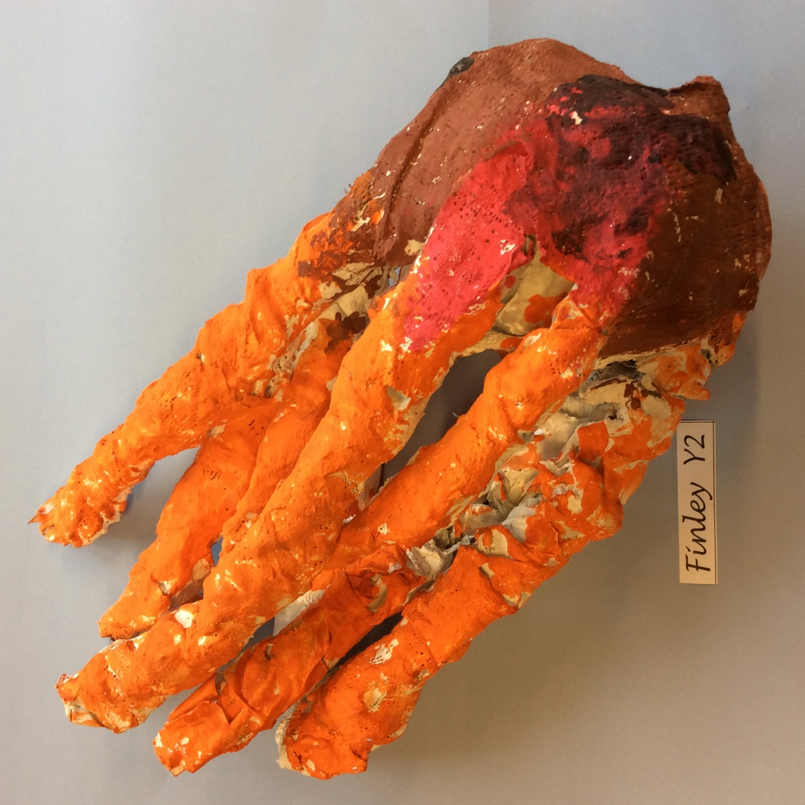

Slide 19
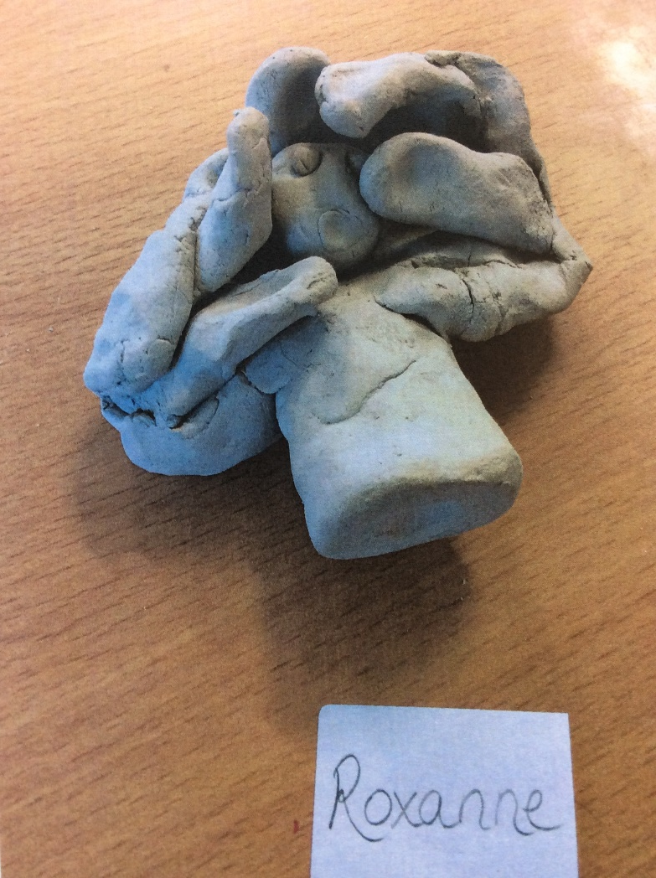
Roxanne
Yr2

Slide 20
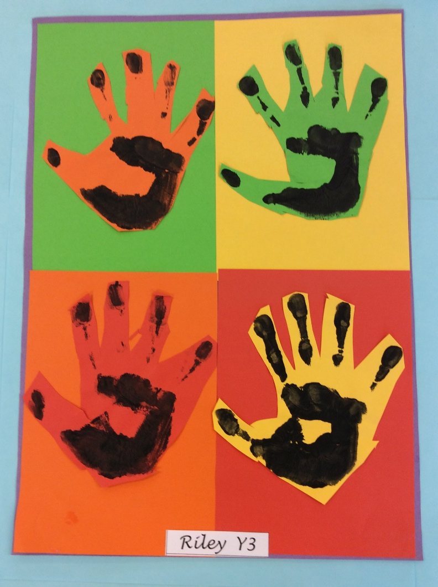

Slide 21
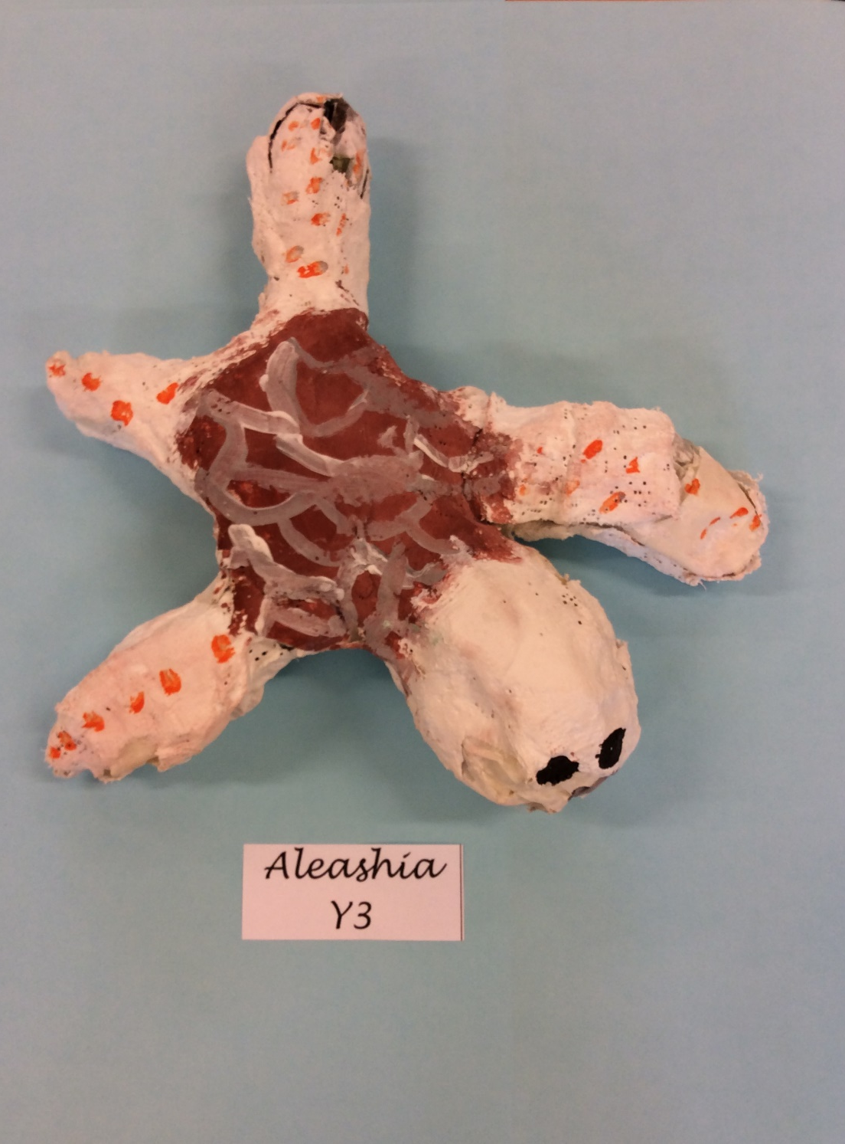

Slide 22
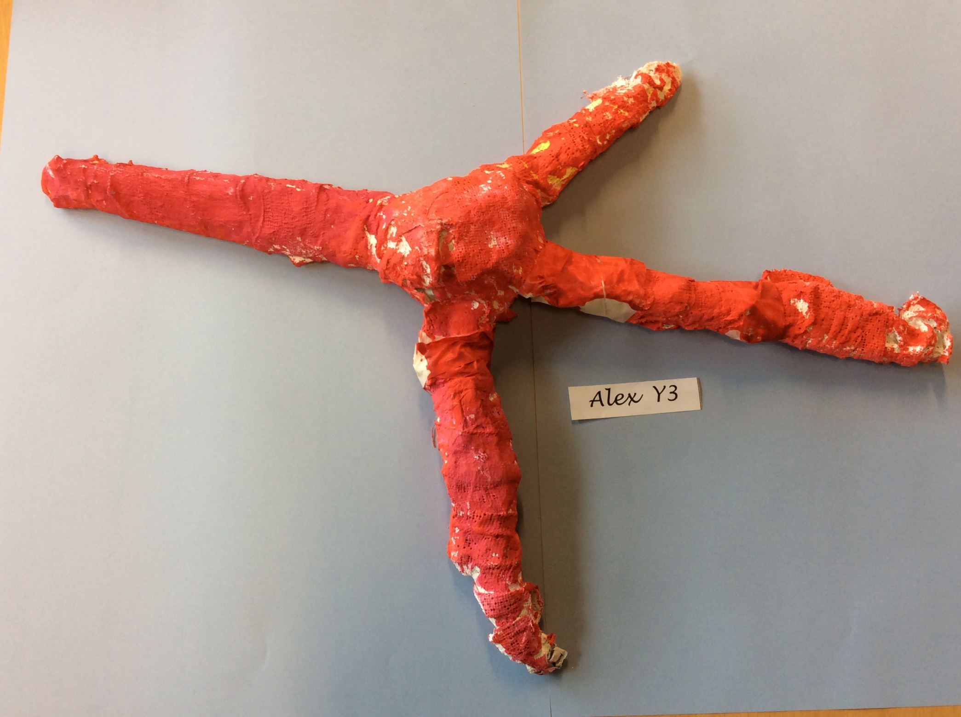

Slide 23
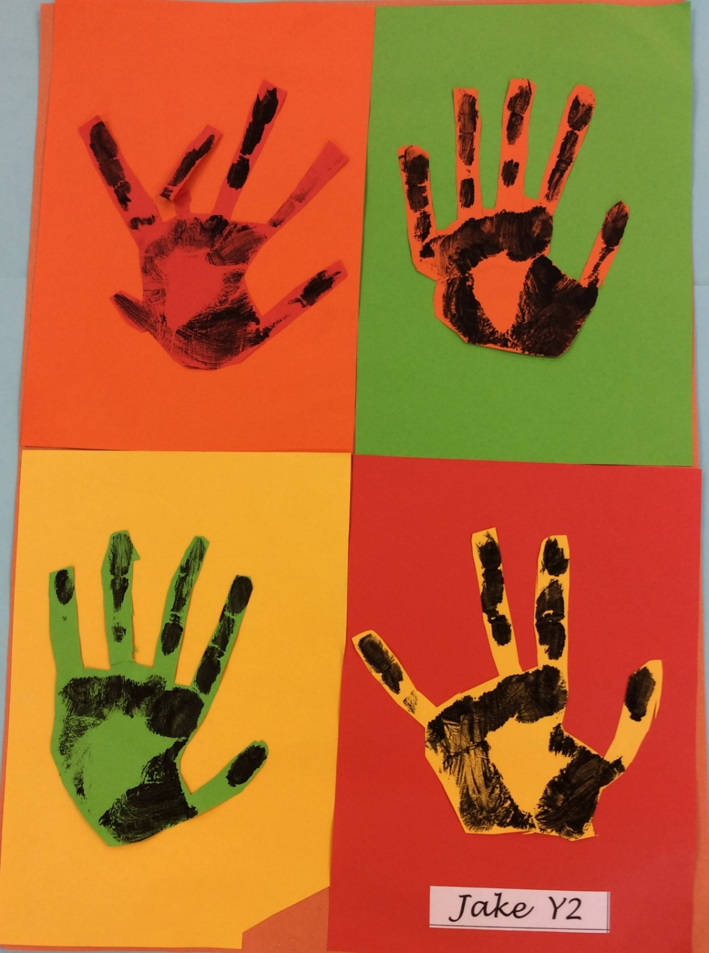

Slide 24
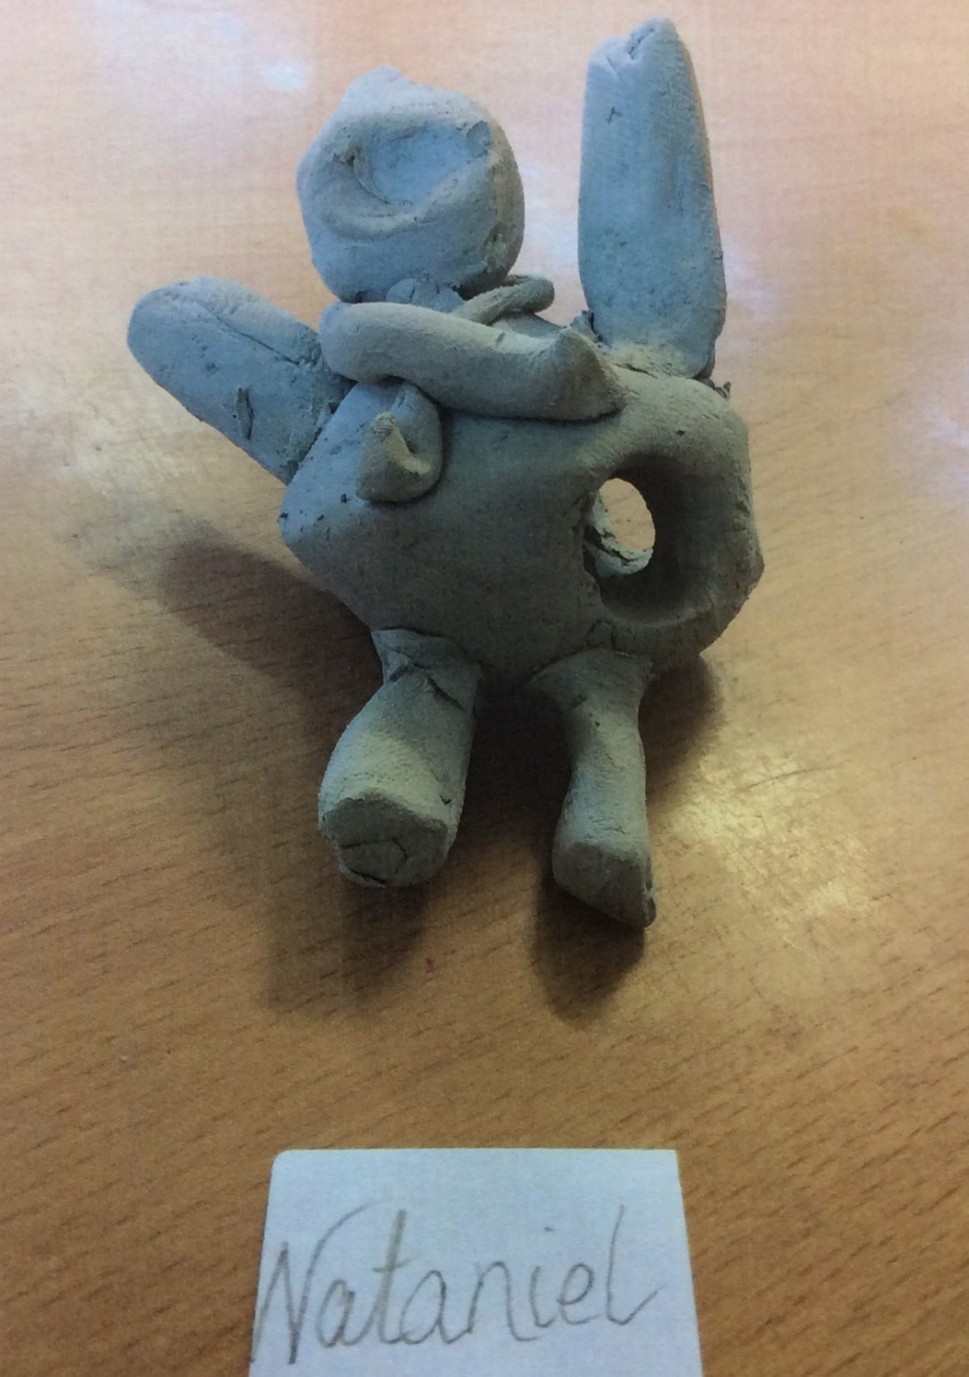
Nataniel
Yr 3

Slide 25
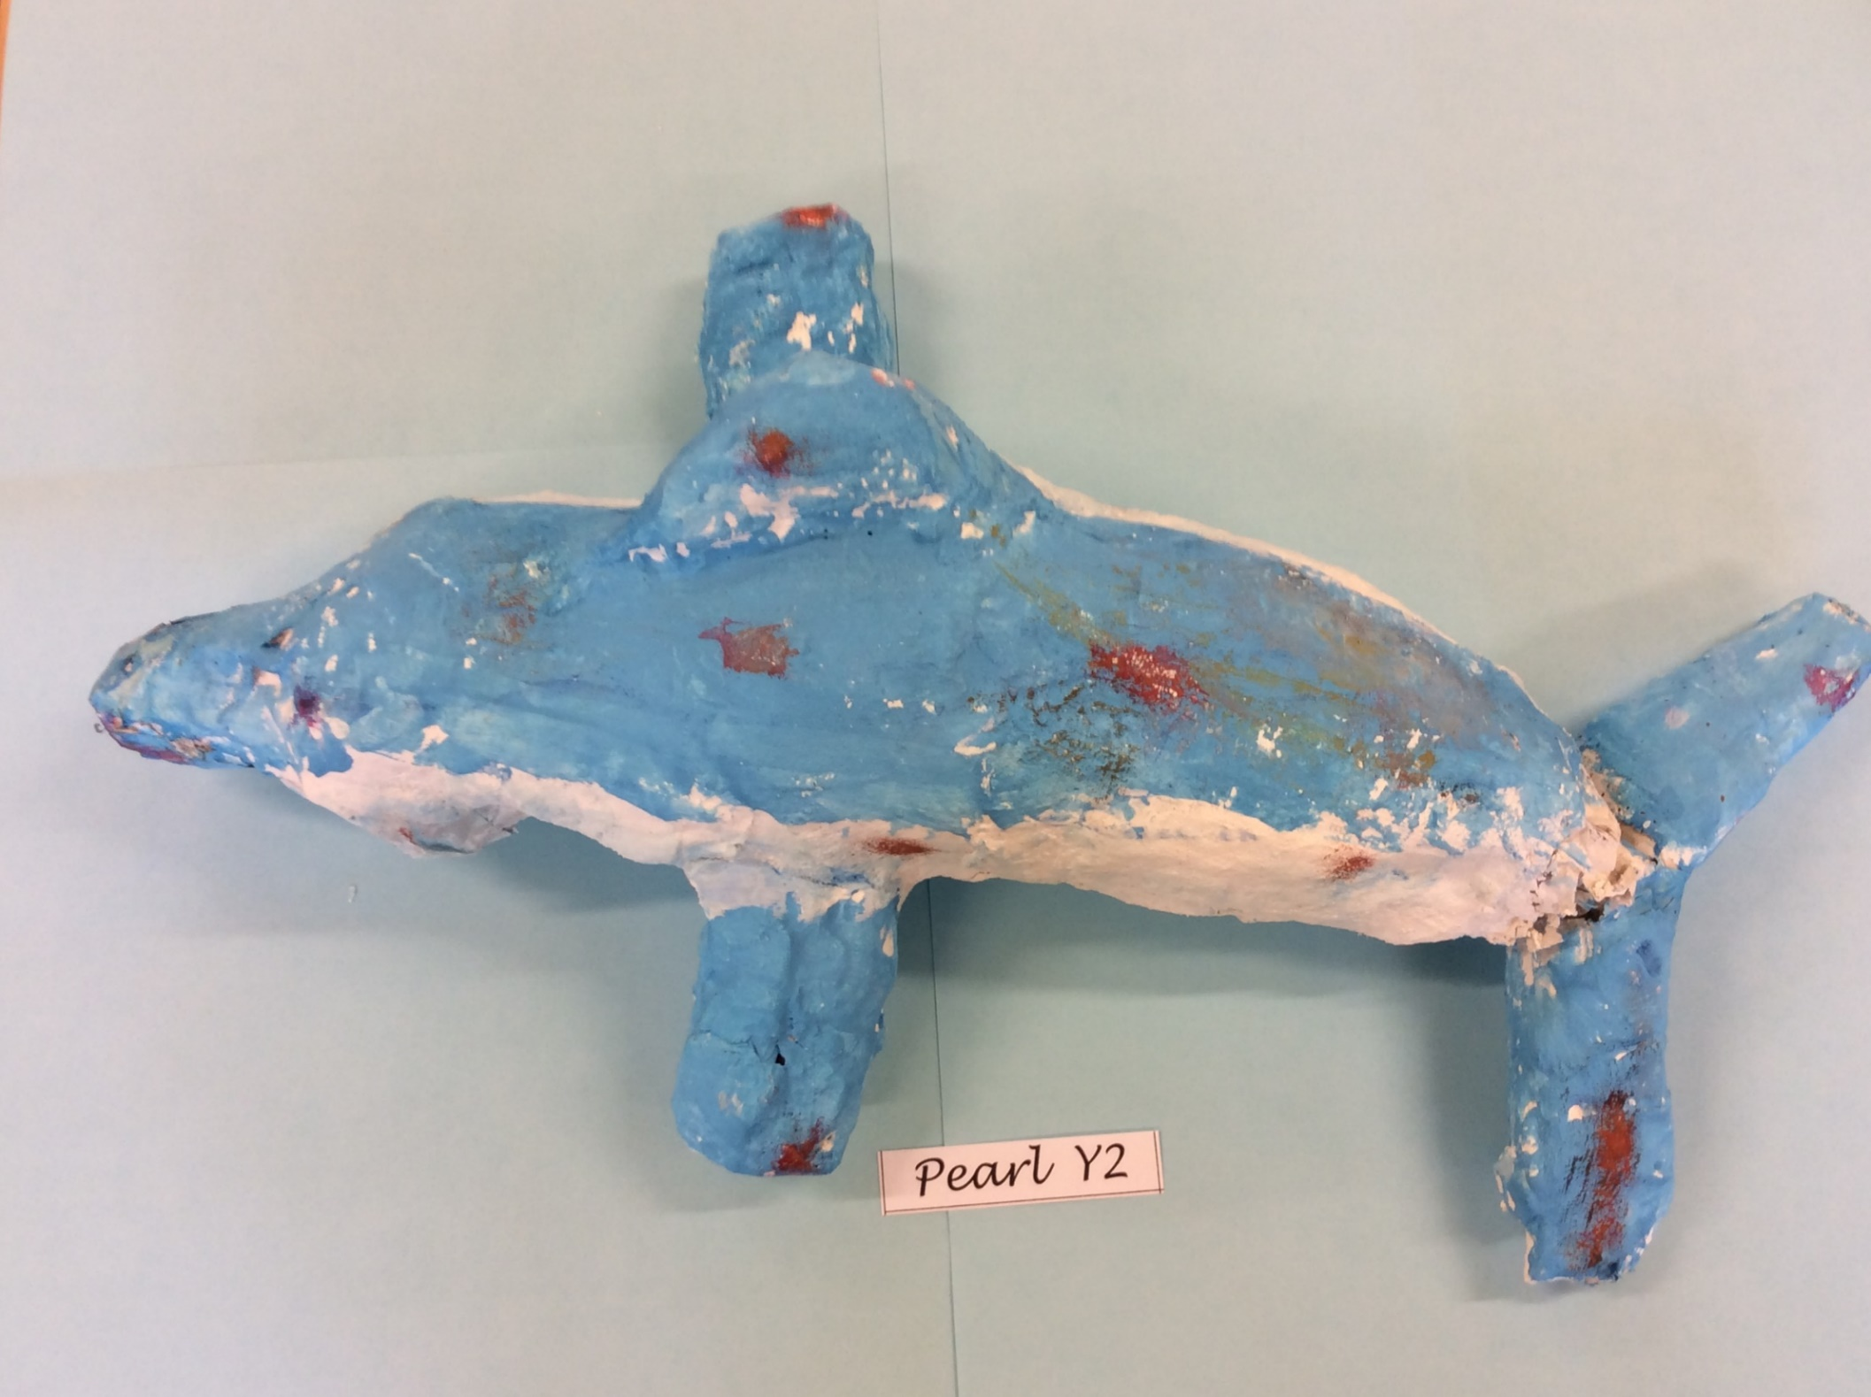

Slide 26
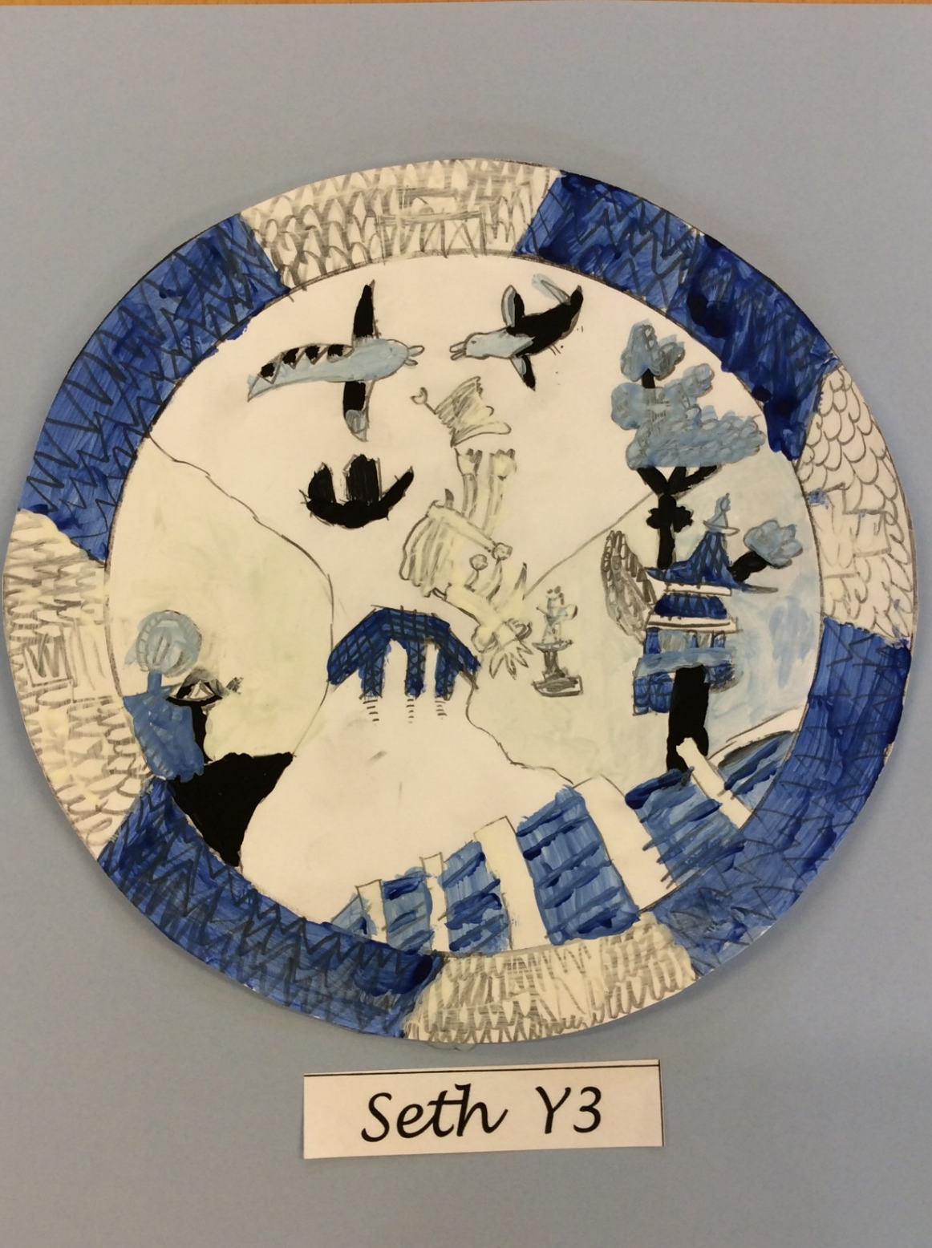

Slide 27
Thank you for watching and we hope you have enjoyed our work.

